Slide 1


Real Time Data Analysis
On E-commerce Simulated Data
Guided By:
Submitted by:
Mr. Anay Tamhankar
Mr. Prasad Deshmukh
More Rishikesh Babu (230343025033)
Vaqash Khan (230343025053)
Vivek Kumar Sahu (230343025054)
Rakesh Kumar Bharti (230343025058)
Notes:
Links:
https://www.pexels.com/photo/people-discuss-about-graphs-and-rates-3184292/

Slide 2
Introduction
In today's dynamic and competitive E-commerce landscape, deriving actionable insights from data is crucial for making informed business decisions. This presentation delves into the exciting realm of real-time data analysis using simulated e-commerce data. By combining the power of MongoDB for data storage, Apache Spark for data processing, Kafka for real-time data streaming, and Tableau for visualization, this project delivers comprehensive insights into customer.

Slide 3

Problem Statement
In this project we have tried to solve the problem faced by ecommerce companies using simulated data for understanding overall integration of different technologies.

Slide 4





Architecture
Python
Generating Simulated Data Using Python
Kafka
Generate Real-Time Event
Pyspark
Processing Data in Pyspark
Report
MongoDB
Storing Data in MongoDB
Tableau
Visualise Data in Graphical Manner to get trends and Pattern

Slide 5
Generating Data through Python Simulation using Faker Library
Storing Synthetic Generated Data by Python Simulation in MongoDB Database
Using Generated Data in Kafka To Generate Real-Time Event
Connecting MongoDB and PySpark To Process MongoDB Data
Connecting MongoDB and Tableau via MongoDB Connector: Visualizing Patterns for Decision Making

Slide 6
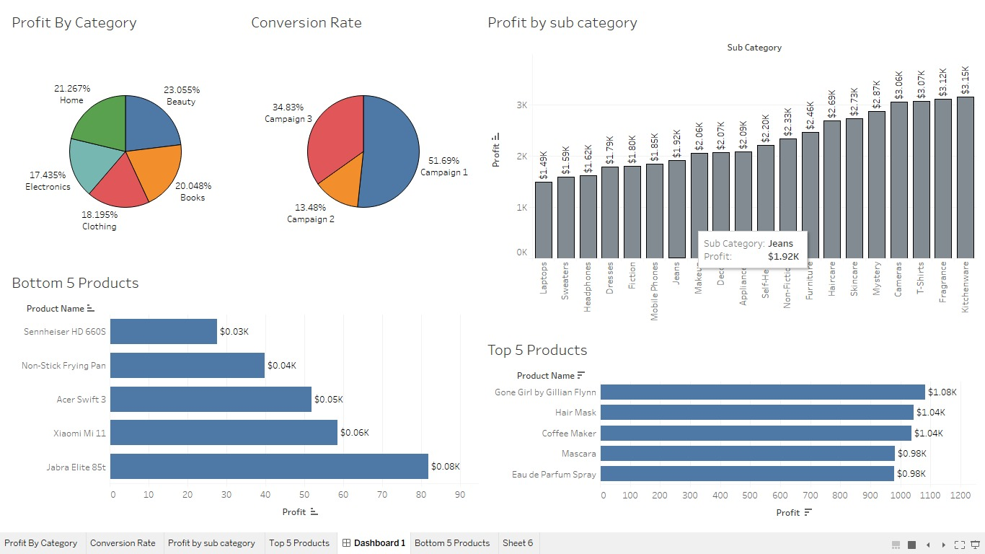
E-commerce Dashboard

Slide 7
Future Scope
This Project can be used in Production by using High End Simulation
We can Develop Personalised Market Campaign
We can use NLP Sentiment Analysis

Slide 8
Conclusion
This project aim to comprehensive e-commerce simulation and analytics platform. By leveraging synthetic data generation, MongoDB for data storage, Apache Kafka for streaming, Apache Spark for data processing, and machine learning techniques, we successfully designed a robust end-to-end solution for analyzing and understanding e-commerce operations.

Slide 9
Thank
You

